Slide 1
AUA and Tempus
Lessons Learned
October 6, 2015

Slide 2
Agenda
Introduction to Projects
TNE_QA
GOVERN
PEOPLE
ICo-op
Lessons Learned and Shared
Student Life Cycle Management /Management and Organization of Academic Affairs
Credit and ECTS conversion
Nation-wide standards and procedures for external quality assurance of Transnational Education providers
Best Practices: Policies and Procedures in Human Resources Management
Benefits and Challenges
Questions and Answers

Slide 3
TNE_QA: Promoting quality and recognition of transnational education in Armenia and Georgia
Catherine Buon

Slide 4
TEMPUS Transnational Education – Quality Assurance
TNE_QA is a three-year EU-funded project uniting Armenian, Georgian and EU partners with the objective to develop and integrate quality assurance mechanisms in the institutions that provide transnational education (TNE).

Slide 5
Six Armenian Partners
French University in Armenia, Foundation (project coordinator)
American University of Armenia Foundation
Russian-Armenian (Slavonic) University
National Center for Professional Education QA Foundation
Ministry of Education and Science of Republic of Armenia
Education Quality

Slide 6
Five Georgian Partners
Caucasus University
Akaki Tsereteli State University
Batumi State Maritime Academy
International Institute for Education Policy, Planning and Management
National Center for Educational Quality Enhancement
Ministry of Education and Science in Georgia

Slide 7
Seven EU Partners
The Quality Assurance Agency for Higher Education - United Kingdom
Bath Spa University, United Kingdom
Université Jean Moulin Lyon 3, France
Universität Siegen, Germany
International Institution for Educational Planning, France
EFMD, Belgium
Aix-Marseille University, France

Slide 8
The project has three main activities
1. Capacity building (training kit, training sessions, workshops, case studies, plan and template for the development of QA units at HEIs.)
2. Formulation of internal and external QA procedures for TNE providers.
3. Pilot accreditation of TNE providers (institutional and academic program.)

Slide 9
GOVERN: Fostering Autonomy and Accountability: Development of State-of-the-Art Higher Education Management System for Efficient Changes in Line with Bologna Principles
Stella Kostanyan

Slide 10
Tempus GOVERN
Fostering Autonomy and Accountability:
Development of State-of-the-Art HE Management System for Efficient Changes in Line with Bologna Principles
GOVERN is a three-year national project.
Partners: 22 partners: 16 from RoA, 6 from Europe.
Coordinated by Yerevan State Academy of Fine Arts.

Slide 11
Wider Objective
The wider objective is to enable application of the state-of-the-art management system at Armenian HEIs for promoting effective and efficient structural changes in line with Bologna agenda thus enhancing HEIs autonomy and accountability.

Slide 12
Specific Objectives
The specific objectives target enhancement of autonomy and accountability of HEIs through:
building on the capacity of administrative staff for managing system changes efficiently;
revising the legal (system level) and regulatory (HEI level) frameworks in line with Bologna action lines;
establishing the state-of-the-art university management system through overhaul of approaches to system changes: strategic, financial and human resource management
introducing working approaches to student-centered educational provisions: ECTS and academic program management to assure quality and promote student mobility.

Slide 13
The Principle Outcomes/Outputs
Building on capacity of top and middle level administration to enable Bologna action lines implementation;
New legal (system-wide) and regulatory (HEIs) frameworks in line with Bologna lines;
State-of-the-art management system based on new approaches to strategic and structural management, budget allocation, human resource management;
Indicators and criteria for academic program and student mobility operationalization;
New approaches to managing academic program and office of academic affairs and registrar (installation of student portal and student affairs information management system).

Slide 14
Capacity Building
A lot of people from AUA participated in the Govern project’s workshops.
The trainings aimed at sharing experiences and best practices in
strategic planning,
operation of the office of registrar and academic affairs,
strategic and structural management,
financial and HR management.
The study tour aimed to provide deeper understanding of the role and functions of different administrative units intended to promote the strategies of HEIs.

Slide 15
Project’s Activities
fact-finding and gap analysis for development of student-centered academic program,
development of national ECTS guideline,
external review of local HEIs,
adjustments in the strategic and structural management system.

Slide 16
PEOPLE Promoting Educational Organization through peoPLE
Arina Bekchyan

Slide 17
About the Project
PEOPLE - Promoting Educational Organisation through peoPLE
Duration:
36 months, from December 2013 through November 2016

Slide 18
Project Objective I
Objective: To reinforce top and middle managers of higher education institutions competencies by developing a human resource management and staff development strategy focusing on the challenges of the economic transition process of the partner countries and globalization that are impacting higher education institutions, through:
conducting audit of HR processes and procedures in order to find out the strengths, weaknesses, opportunities and threats this domain is currently facing
performing training needs detection throughout a map of competencies on HR in HEIs
conducting a training for trainers (experts in the field of HR in the partner countries) which will further train the HR academic and staff people at each partner university

Slide 19
Project Objectives II
carrying out training seminars on HR most relevant processes (identified in the previous objective) in order to improve the competencies of top and middle managers
developing a strategic plan for the development of HR in each partner university taking into consideration their specific results of the audit analysis
implementing the strategic plan during the second and the third year of the project in order to follow up deviations and improve results
creating a specific resources center at each partner university with materials as well as an online platform with shared information on HR
creating a printed handbook of HR materials with the results of the training and the HR standardized processes

Slide 20
Project EU Partners
Scientific Coordinator:
UNIVERSITAT POLITÈCNICA DE CATALUNYA (SPAIN)
EU Partners:
ROYAL INSTITUTE OF TECHNOLOGY (SWEDEN)
INSTITUTE SUPERIOR TECNICO de LISBOA (PORTUGAL)

Slide 21
Kazakhstan Partners
Coordinator of the Project:
T. RYSKULOV NEW ECONOMIC UNIVERSITY
Kazakh Academy of Transport and Communications
Pavlodar State University
Karaganda State Medical University
NGO ASSOCIATION OF HR experts

Slide 22
Georgian Partners
Kutaisi University (Kutaisi)
Ilia State University (Tbilisi)

Slide 23
Armenian Partners
American University of Armenia (Yerevan)
Armenian State University of Economics (Yerevan)
Russian-Armenian Slavonic University (Yerevan)

Slide 24
Ico-op: Industrial Cooperation and Creative Engineering based on Remote Engineering and Virtual Instrumentation
Knarik Gevorgyan

Slide 25
ICo-op – Armenia About the Project
Duration – 36 months (October 12, 2012 – October 15, 2015)
Goal - Empower university-enterprises partnership in Armenia, Georgia, and Ukraine by modernizing engineering education based on remote engineering and virtual instrumentation.
Objectives:
Establish methodology for identification and monitoring of demand for knowledge and skills in industry
Create and implement learning programs that will incorporate transversal electronics technologies using remote laboratories and virtual instrumentation knowledge
Build mutually beneficial, sustainable partnerships between academia and enterprises by offering internship programs for university and up-to-date training programs for industry
American University of Armenia
National Polytechnic University of Armenia
Kapan Branch of NPUA

Slide 26
Project Partners
Higher Education Institution |  | Small and Medium Sized Enterprise
P01 - Ilmenau U of Technology - Coordinator
P02 - Carinthia U of Applied Sciences |  | P05 - Quality Austria
P03 - University of Deusto
P04 - “TRANSILVANIA” U of Brasov
P06 - “Kharkiv Polytechnic Institute” |  | P15 JSC Ukrainian Industrial Energy Company
P07 - Ivano-Frankivsk Nat. Tech. U of Oil and Gas |  | P16 - Research and Production Company ZOND
P08 – Zaporizhzhya National Technical U |  | P18 - Ecological Systems ltd
P09 - Ilia State University |  | P17 - Micro and Nano Electronics Institute
P10 - Shota Rustaveli State University |  | P19 - Transformer and Electric Equipment
P11 - American University of Armenia |  | P21 - National Instruments - Armenia
P12 - State Engineering U of Armenia |  | P22 – Synopsis
P20- Kapan Campus of the SEUA

Slide 27
ICo-op – Armenia About the Project
Work Package # | Title of the Work Package
WP.1 | Analysis of the existing situation and requirements of the labor market: AM, GE, UA. Conceptual Design of Program
WP.2 | Program learning environment implementation
WP.3 | Modules: Design and production
WP.4 | Pilot realization of program: high education and industry training
WP.5 | Quality assurance and evaluation
WP.6 | Dissemination and sustainability
WP.7 | Management and Coordination

Slide 28
ICo-op – Armenia About the Project
Work Package # | Title of the Work Package
WP.1 | Analysis of the existing situation and requirements of the labor market: AM, GE, UA. Conceptual Design of Program
WP.2 | Program learning environment implementation
WP.3 | Modules: Design and production
WP.4 | Pilot realization of program: high education and industry training
WP.5 | Quality assurance and evaluation
WP.6 | Dissemination and sustainability
WP.7 | Management and Coordination

Slide 29
Student Life Cycle and Student Experience (through UMS)
Gayane Davoyan Chaghig Arzrouni-Chahinian

Slide 30
“Studying is more than just collecting credits + earning degree, it is a life experience, if you offer a good experience your intrinsic quality is augmented and increased.”
Complete student life cycle/Experience is individual + subjective + collective issue
From the moment a pupil is searching and considering higher education (Enquirer)
Sub-processes in applicant experience/ perception and expectations regarding university
Decision to apply to the university (Applicant)
Academic +campus experience (Student)
Graduate experience (Alumni)

Slide 31
Student Life Cycle and UMS

Slide 32
Life cycle: Student’s Point of view
Student
Discover/Inquire
Commit/Apply
Enroll/Stay
Learn
Graduate
Alumnus/Donate

Slide 33
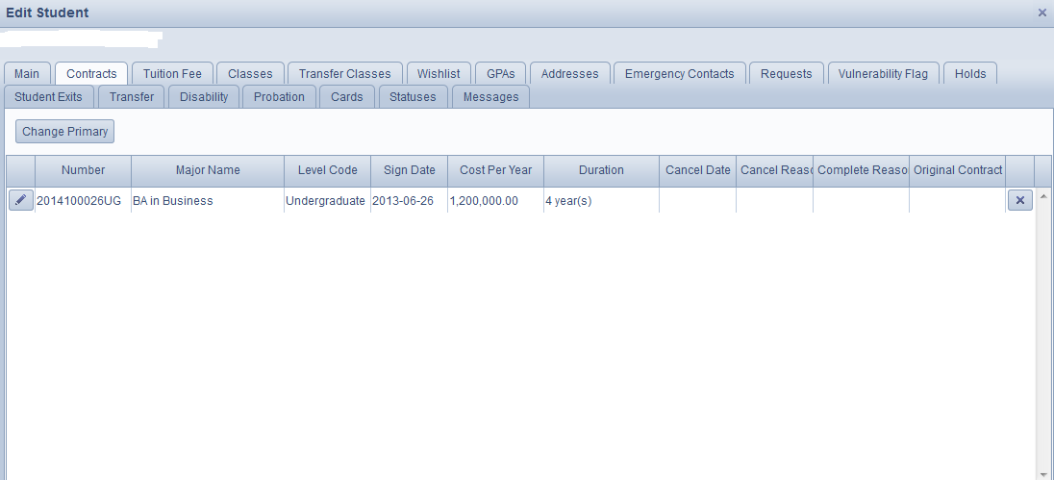

Slide 34
Tracking student through UMS

Slide 35
Foundations for us to develop
Student experience
Commitment
Academic analytics
Mobility +portability
employability
Individualize
Community

Slide 36
Actors and Stakeholders
Student
University
Local community/world
Not just a consumer client/knowledgeable and capable committed person
Own needs/expectations
Help realize the experience
Creation of community
Actively involved
Positive experience
Induction through equitable access
Build around talents and the passion of the student (access to ums of various stakeholders to ensure that the student is inspired to succeed in retention)
University vision +mission
3 pillars of higher education
Campus life
Own uniqueness “story to tell”
Local and global

Slide 38
Access to UMS to ensure retention
Ensure uninterrupted student life cycle
Strong system of student support through academic support units
Improve retention through efficient cooperation and information flow between support units
Personal development planning model/training
Identify information for access to identify student needs

Slide 39
Uninterrupted student life cycle/access of academic support units to UMS
Registrar
Financial aid
Student success/ Alumni
Admission

Slide 40
Credit and ECTS conversion
Anna Karapetyan

Slide 41
Development of Guidelines
Formation of a working group on the revision of ECTS implementation in Armenian institutions
Comparative analysis of ECTS and its components at European, national and institutional levels
Development of the draft Guidelines for ECTS users at universities
List of documents requested from local partners related to Bologna process and ECTS implementation
Revision of the draft guidelines based on the comparative analysis of documents; feedback provided by partners
Preliminary proposal of recommendations to be submitted to MoES
ECTS Users Guide: http://ec.europa.eu/education/library/publications/2015/ects-users-guide_en.pdf
AUA Credit Hour policy: http://policies.aua.am/policy/34

Slide 42
Benchmarking: ECTS to US Credits
University | Conversion | Reference
University of North Carolina at Charlotte | 1. ECTS credit hours should be divided by 2 to determine the standard US equivalent credit amount. 2. If the number determined in step 1 is higher than a regular block of 3 or 6 credits, the UNC Charlotte credit award amount should be rounded down to the next logical credit block, which would typically be 3 or 6 hours. | http://provost.uncc.edu/policies/ECTS-equivalency
William & Mary, US | 3 ECTS = 1.5 W&M credits; 4 ECTS = 2 W&M credits; 5-6 ECTS = 2.5 or 3 W&M credits; 8 ECTS = 4 W&M credits | https://www.wm.edu/offices/revescenter/studyabroad/students/onceacceptedwhileabroad/coursecredit/index.php
Northern Arizona University | 2 ECTS credits = 1 NAU credit (In case of a 5 ECTS course students may receive 3 NAU credits) | https://edabroad.nau.edu/index.cfm?FuseAction=Abroad.ViewLink&Parent_ID=D1365D7C-155D-8A49-B480FBF7FBBDE34B&Link_ID=D13E5BC0-155D-8A49-B4638020F8E3E4BE
Central European University | 1 US credit = 2 ECTS. In ECTS, credits are calculated based on the work done by the student outside the classroom while US credit are based on taught classroom minutes; in ECTS, one academic year is equivalent to 60 ECTS credits (for example, students in a two-year MA are to complete 120 credits). | Central European University US credit to ECTS conversion policy: https://www.ceu.edu/

Slide 43
Nation-wide standards and procedures for external quality assurance of Transnational Education providers
Anna Karapetyan

Slide 44
Areas of Project Activities
Capacity building (training kit, training sessions, workshops)
Development of internal and external QA procedures for TNE providers
Pilot accreditation of TNE providers

Slide 45
TLIs in Armenia
National TLIs
Public and private
Intergovernmental institutions
Cross-boarder provider mobility
Main campus
Branch campus
Virtual university
Cross-boarder programme mobility
Franchise
Dual/Joint degree

Slide 46
National Approach
Armenia has adopted fitness for purpose principal.
TNE provider should declare:
Its mission and purpose as an education provider
University model effectiveness
Satisfaction of local labour market demands
Performance on an institutional level to consider home institution’s/model limitations

Slide 47
National Accreditation Criteria and Standards
Institutional accreditation criteria
Mission and purpose
Governance and administration
Academic Programme
Students
Faculty and staff
Research and development
Infrastructure and resources
Social responsibility
External relations and internationalization
Internal quality assurance

Slide 48
Consideration of UNESCO Guidelines
Programme
Faculty
Governance and administration
Internal quality assurance
Information
External quality assurance
Development of indicators for each area specific for TNE

Slide 49
TNE Accreditation
Main focus:
TNE institution should consider national interests and act to meet specific needs of that society
accreditation agency should consider both the particular systems/structures/models of the universities and local specifications
accreditation agency should facilitate mutual recognition of qualifications, promote internationalisation
accreditation agency should promote the international recognition of the accreditation results in the respective countries

Slide 50
TNE Accreditation: How to organize
By local agency with the consideration of UNESCO guidelines within the local framework
self-assessment
expert panel review
report
decision making
Joint accreditation
common assessment framework and procedure
jointly appointed expert panel
one compiled report
By foreign agency
informing ANQA of intent to apply for accreditation by the foreign agency (list approved by MoES)

Slide 51
Follow up of Procedures
The project envisions the following:
Pilot accreditation of TNE providers
Commendation and recommendations
Adjustment of the procedure
Draft TNE policy guideline presented to MoES for approval

Slide 52
Best Practices: Policies and Procedures in Human Resources Management
Anahit Ordyan

Slide 53
Project Activities: What has been done so far
Kick-off meeting – MARCH 2014
Audit of HR processes and procedures and training needs detection throughout a map of competencies on HR in HEIs: conducted by EU partners – JULY 2014
TOT (for experts in the field of HR in the partner countries)– for further training of the HR academic and staff people at each partner university – OCTOBER AND NOVEMBER 2014
Training/seminars for the HR academic and staff people at local universities – FEBRUARY-MAY 2015
Training on Strategic Planning – MARCH 2015
Dissemination: 1st International Conference in Kazakhstan –OCTOBER 2015

Slide 54
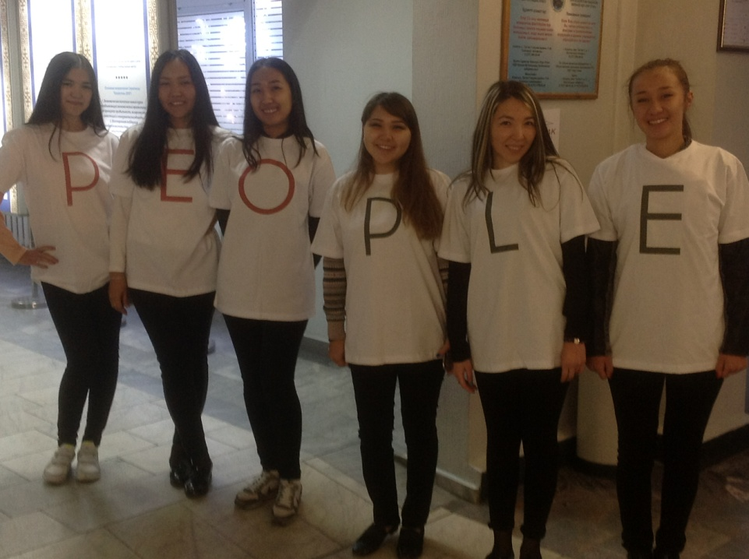
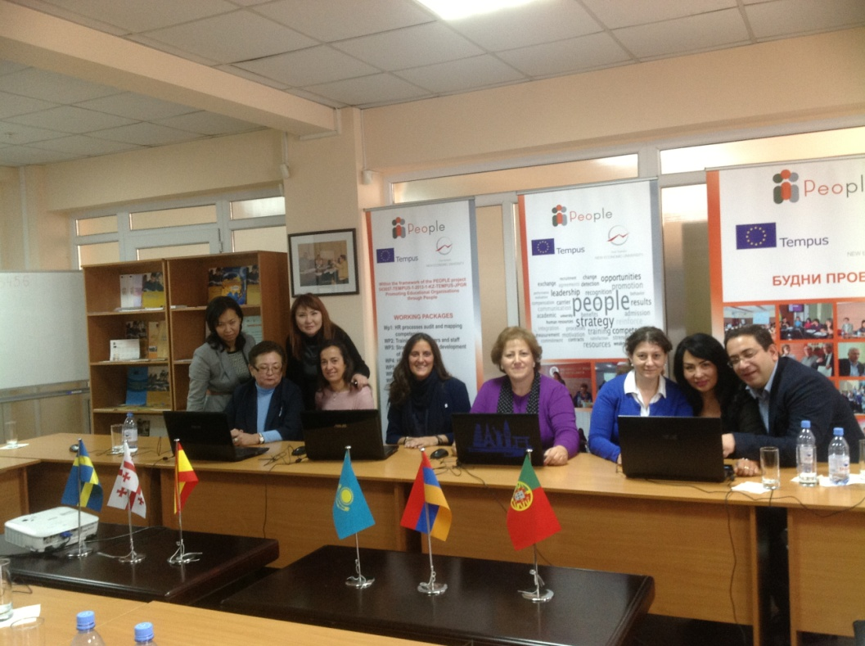
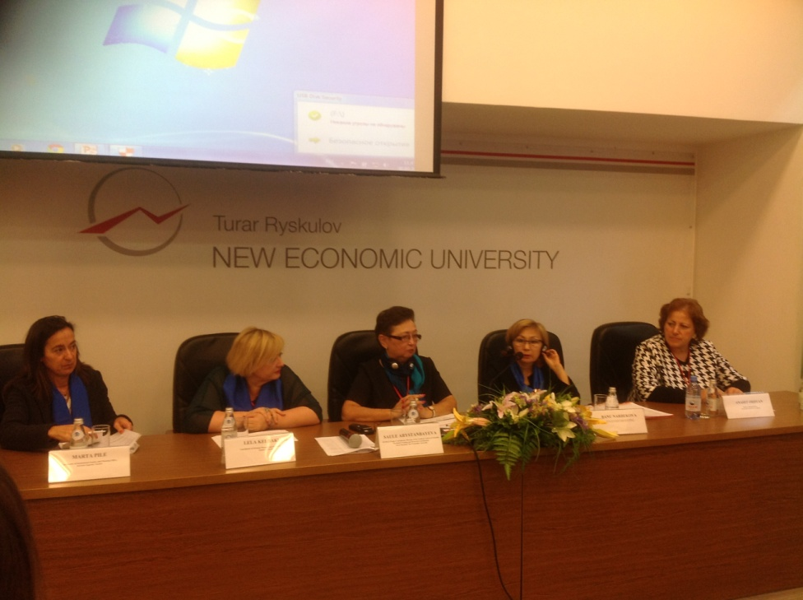
Pictures from recent Almaty Conference

Slide 55
Project Activities: What is planned
Develop a strategic plan for the development of HR in each partner university taking into consideration their specific results of the audit analysis – DECEMBER 2015
Conduct audit visits by partner institutions
Create a specific HR resource center at each partner university with materials, including an online platform with shared information on HR– YEAR 2016
Create a printed handbook of HR materials with the results of the training and the HR standardized processes– YEAR 2016
Develop/implement dissemination and sustainability strategy – INTERNATIONAL CONFERENCES – in GEORGIA –JUNE 2016 and in ARMENIA – SEPTEMBER 2016

Slide 56
How to Promote Project Sustainability
On going trainings and seminars
On-line shared resources and platform
HR printed handbook
New cycle of strategic plan

Slide 57
A Few Words on PEOPLE Project Activities
Series of Seminars
5 seminars -- On May 27, 2015, AUA hosted the last of a series of five one-day training sessions for 26 HR managers and specialists from
10 universities in Yerevan
4 universities in Gyumri
1 university in Gavar
Evaluations were extremely positive

Slide 58
Seminars-- Statistics
February 23, 2015
Topics covered:
HR Manual: Policies and Procedures
HRM Structures
Recruitment Process and Procedures including Competency-based Recruitment
March 30, 2015
Topics covered:
Communication
Performance Evaluation

Slide 59
Seminars- Statistics
April 29, 2015
Topics covered:
Negotiation and Persuasion,
Staff Satisfaction and On-line Surveys,
Managing Conflict in the Workplace.
May 19, 2015
Topics covered:
Team Building,
Change Management.
May 27, 2015
Topics covered:
Time Management
Job Safety and Security

Slide 60
Cooperation with faculty and staff within the Project
Arpie Balian
Arina Bekchyan
Anahit Ordyan
Hilda Grigorian
Mary Boghosian
Stepan Khzrtian
Armen Gharibyan

Slide 61
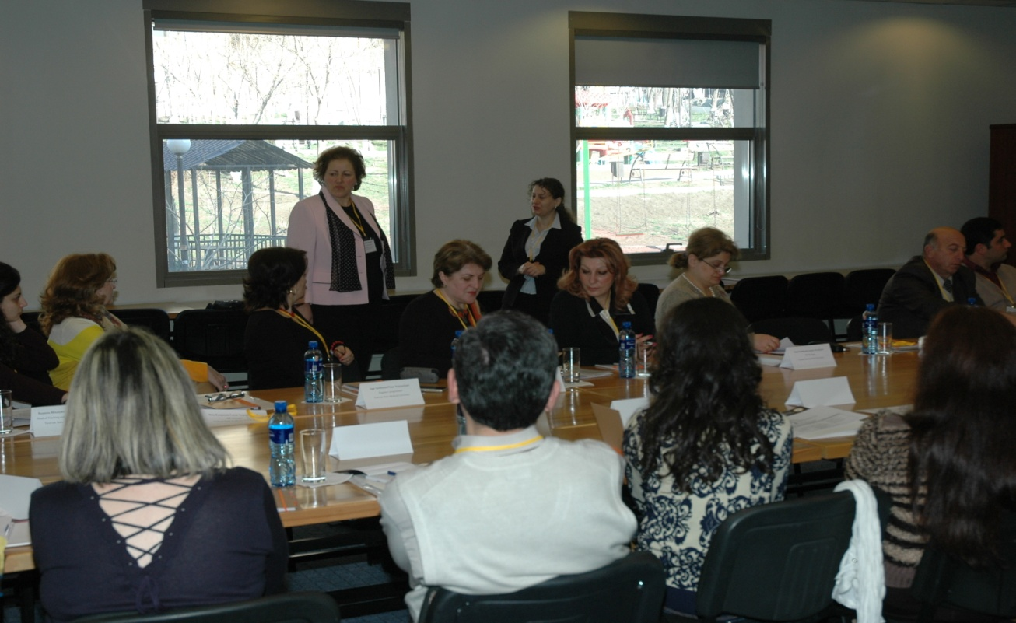
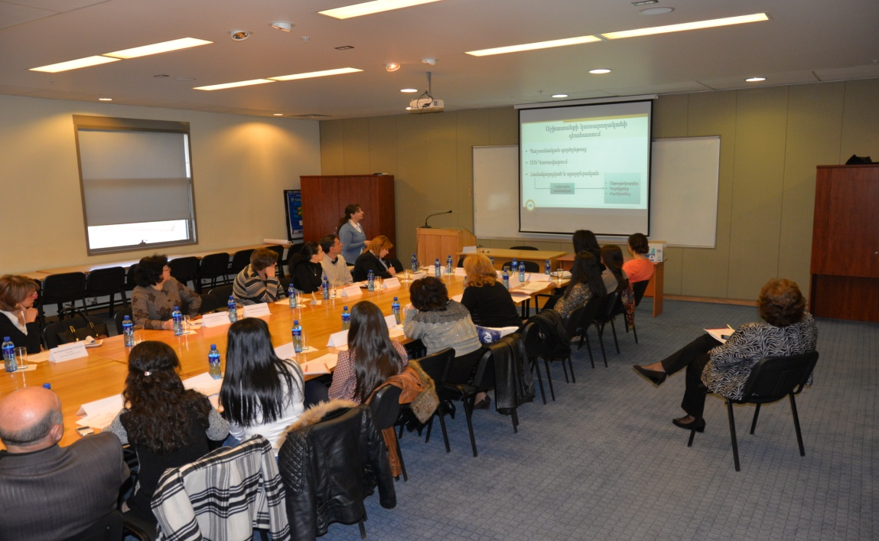
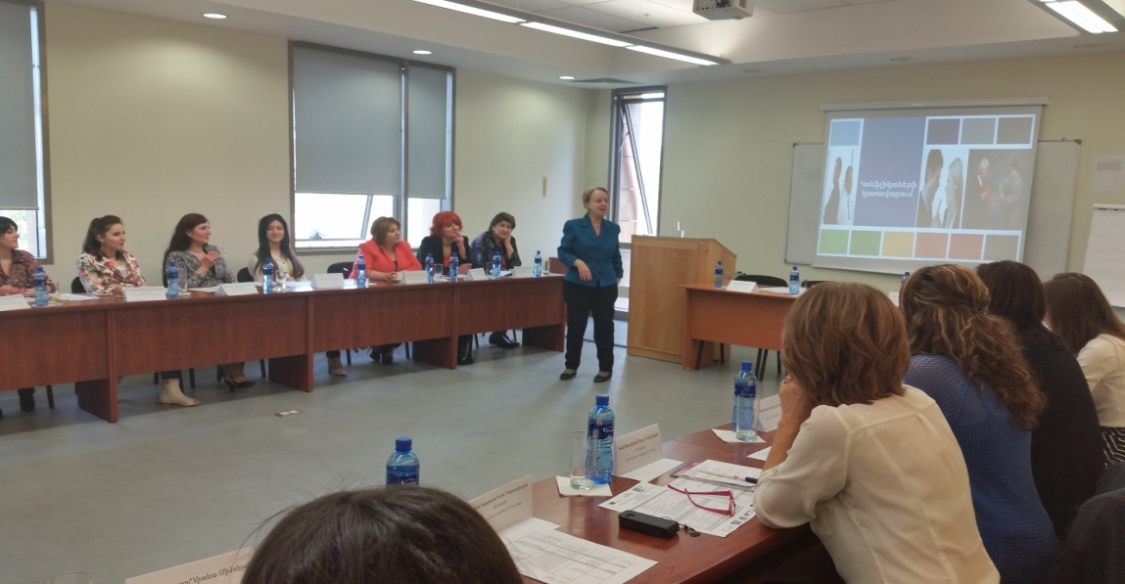
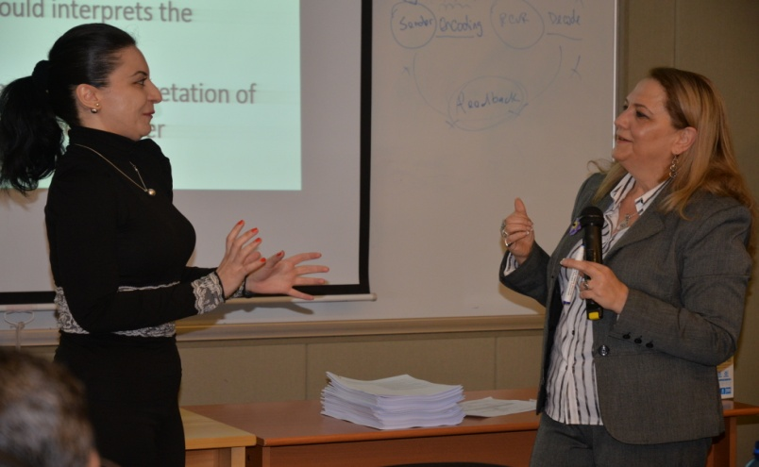
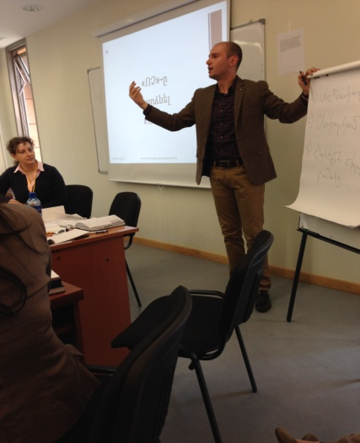
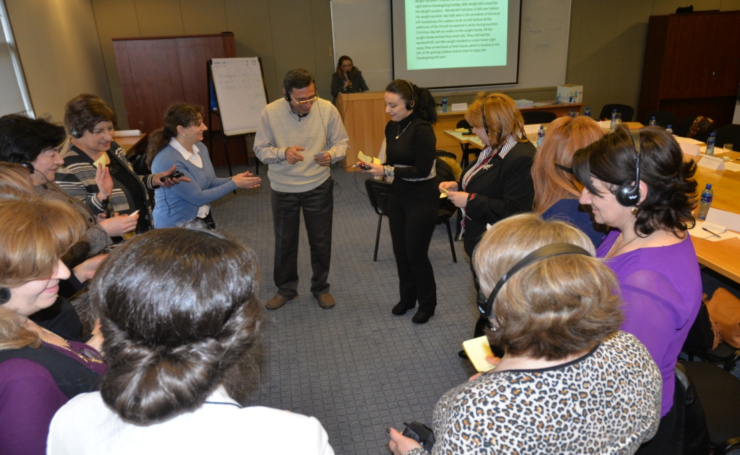
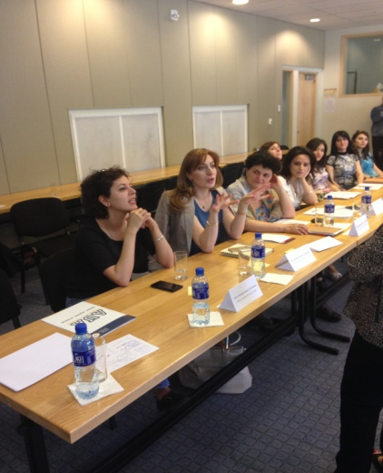
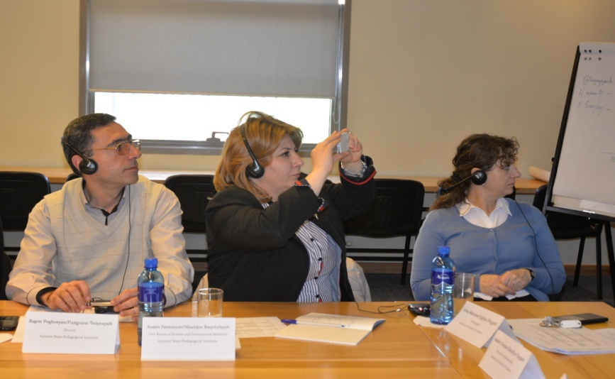

Slide 62
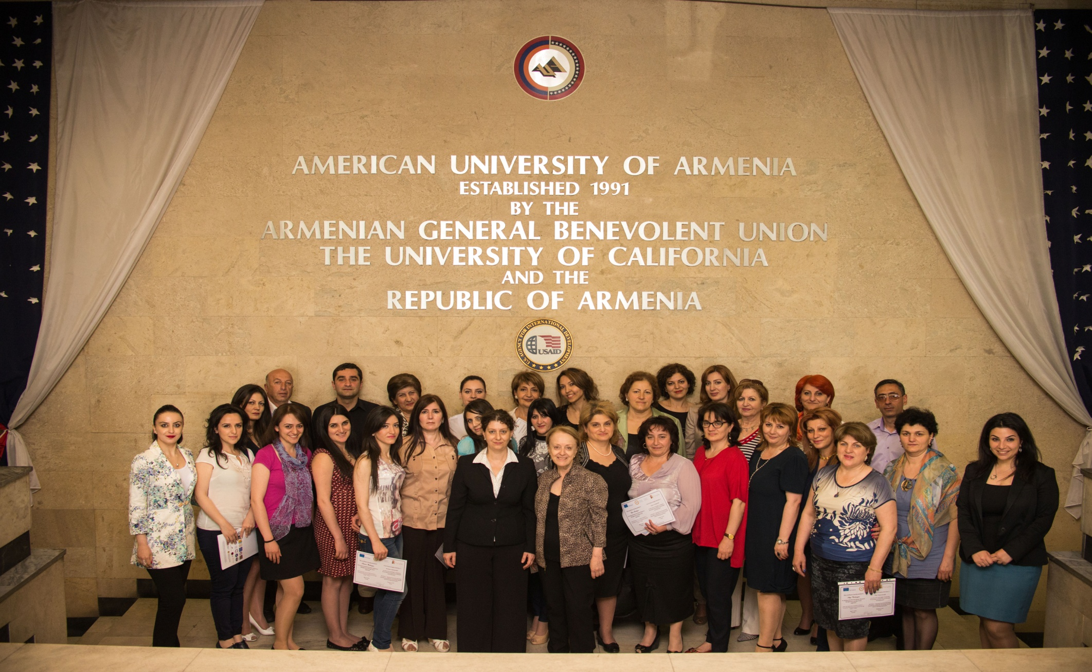
Group Photo: Seminars’ Participants

Slide 63
Lessons Learned and Priorities
Effective exchange of experiences/best practices - a few examples
Fully on-line HRM available in European partner institutions (time management, Performance evaluations, leaves of absences, etc.), easily accessible by every employee
A contract signed for purchasing a software - Discussions in process
Separate training/development department available at UPC
Annual plan
Feedback after 6 months
Individual plans for training starting the first day of employment
Need to have new developments in 2016
Digitized archive of personnel files

Slide 64
Challenges and Benefits
Hayarpy Sahakian

Slide 65
Challenges
Adaptation of some of the tools suggested by the external partners
Financial reporting – difficult to understand, no training
Terminology – consistency of
Need for further clarifications in legal and regulatory frameworks for the implementation of Bologna requirements
Excessive paperwork making the process time-consuming (not efficient)
Time spent on travelling versus time spent in meetings
Last-minute meetings

Slide 66
Benefits
Capacity building of university staff and faculty
Networking with other institutions: sharing challenges, ideas and experiences
Collaboration with international partners, feedback and tools provided based on international experience
Direct involvement in the pilot external review procedures and sometimes also as observers
Promoting the revision of strategic documents and/or templates
Benchmarking of American education elements against European practice for further policy developments to promote student mobility (draft U.S. credit – ECTS conversion guide)
Development of framework for transnational education quality assurance
Dissemination of project outcomes (internal/external). Non-partner institutions have an opportunity to participate in final conference where outcomes/experience are shared.

Slide 67
AUA and Tempus
http://aua.am/tempus-and-aua/

